Slide 1

ANALYSIS
ON
Air Quality Analysis
In
India
SUBMITTED BY:
Abhinav Sharma

Slide 2
Project Objective and Description
Analysis On Air Pollution In India Dataset
On Chosen
OBJECTIVES
Link to Google Drive –
https://drive.google.com/open?id=1EAR0af_1_KgN0FAJkZaQh89sk6tJ84AI
Air pollution occurs when harmful or excessive qualities of substances including gases, particles, and biological molecules are introduced into the Earth's atmosphere. Air pollution in India is a serious issue, ranking higher than smoking, high blood pressure, child and maternal malnutrition, and risk factors for diabetes. At least 140 million people breathe air 10 times or more over the WHO safe limit and 13 of the world's 20 cities with the highest annual levels of air pollution are in India.

Slide 3
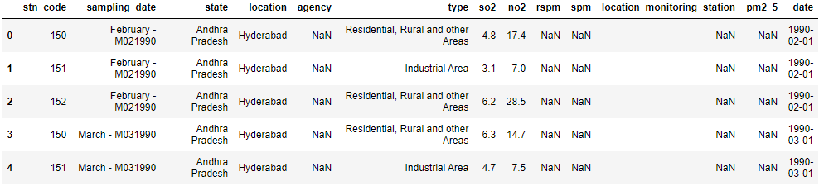
DataSet
Notes:
Context
Since industrialization, there has been an increasing concern about environmental pollution. As mentioned in the WHO report 7 million premature deaths annually linked to air pollution , air pollution is the world's largest single environmental risk. Moreover as reported in the NY Times article, India’s Air Pollution Rivals China’s as World’s Deadliest it has been found that India's air pollution is deadlier than even China's.
Using this dataset, one can explore India's air pollution levels at a more granular scale.
Content
This data is combined(across the years and states) and largely clean version of the Historical Daily Ambient Air Quality Data released by the Ministry of Environment and Forests and Central Pollution Control Board of India under the National Data Sharing and Accessibility Policy (NDSAP).

Slide 4
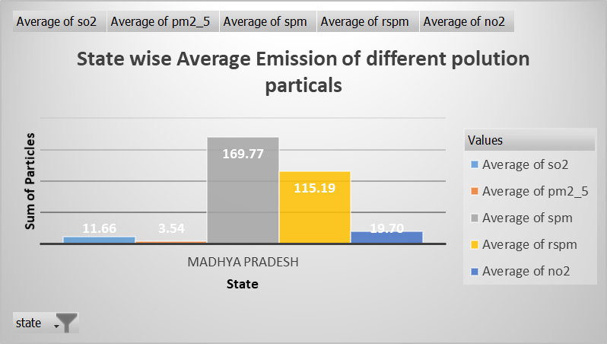
OBJECTIVE 1
State-Wise Average Emission of Pollutants
Notes:
We Try to look into the State wise Average Emission of Pollutants. Like Which are the pollutants in each state and at what level on an Average.
So as an example depicted on the above graphs and on the next slide, almost all states have an high concentration of SPM(Suspended particulate Matter) and RSPM(Respirable Suspended particulate Matter). These are the most hazardous and critically unhealthy for the living beings.

Slide 5
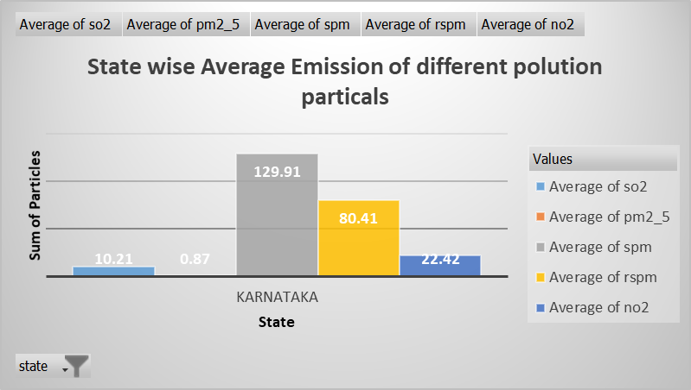
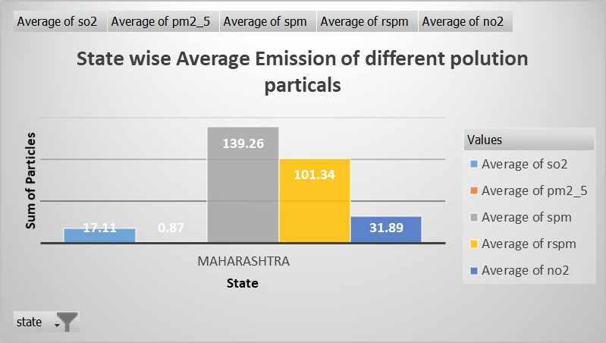
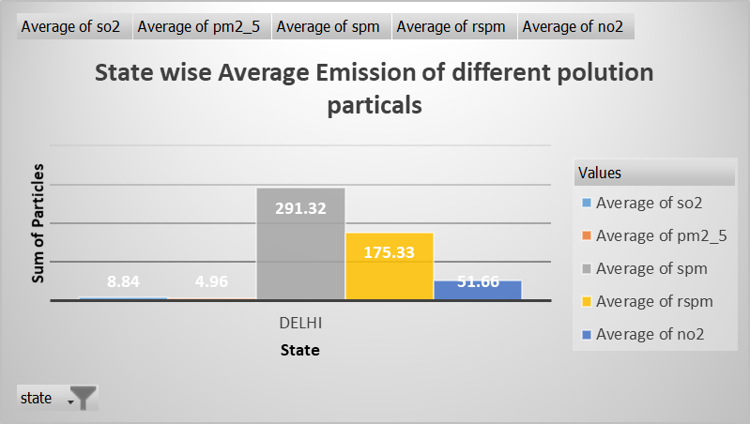
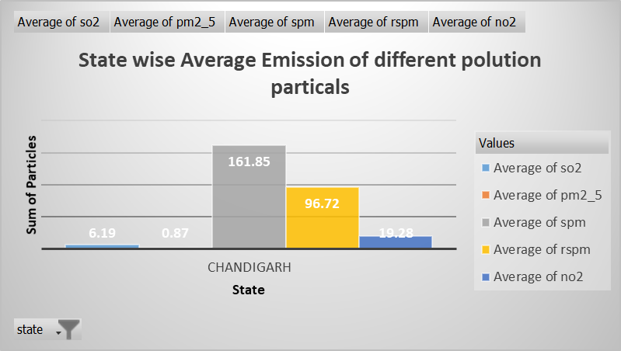

Slide 6
Top 10 States with highest Average So2 Emission
OBJECTIVE 2
RESULT AND ANALYSIS :
States like Bihar, Chatisgarh, Gujrat, Haryana, Maharastra, Sikkim, Uttar Pradesh, Uttarakhand and West Bengal are amongst the highest emitters of So2
Notes:
SO2 : Sulfur dioxide is a gas. It is invisible and has a nasty, sharp smell. It reacts easily with other substances to form harmful compounds, such as sulfuric acid, sulfurous acid and sulfate particles.
About 99% of the sulfur dioxide in air comes from human sources. The main source of sulfur dioxide in the air is industrial activity that processes materials that contain sulfur, eg the generation of electricity from coal, oil or gas that contains sulfur.
Sulfur dioxide affects human health when it is breathed in. It irritates the nose, throat, and airways to cause coughing, wheezing, shortness of breath, or a tight feeling around the chest. The effects of sulfur dioxide are felt very quickly and most people would feel the worst symptoms in 10 or 15 minutes after breathing it in.
Those most at risk of developing problems if they are exposed to sulfur dioxide are people with asthma or similar conditions.

Slide 7
Top 10 States with highest Average No2 Emission
OBJECTIVE 3
RESULT AND ANALYSIS :
States like Bihar, Delhi, Jharkhand, Punjab, Maharastra, Sikkim, Uttar Pradesh, Uttarakhand and West Bengal and Rajasthanare amongst the highest emitters of No2
Notes:
NO2 :Nitrogen dioxide is a nasty-smelling gas. Some nitrogen dioxide is formed naturally in the atmosphere by lightning and some is produced by plants, soil and water. However, only about 1% of the total amount of nitrogen dioxide found in our cities' air is formed this way.
Nitrogen dioxide is an important air pollutant because it contributes to the formation of photochemical smog, which can have significant impacts on human health.
The major source of nitrogen dioxide in is the burning of fossil fuels: coal, oil and gas.
The main effect of breathing in raised levels of nitrogen dioxide is the increased likelihood of respiratory problems. Nitrogen dioxide inflames the lining of the lungs, and it can reduce immunity to lung infections. This can cause problems such as wheezing, coughing, colds, flu and bronchitis.
Increased levels of nitrogen dioxide can have significant impacts on people with asthma because it can cause more frequent and more intense attacks. Children with asthma and older people with heart disease are most at risk.

Slide 8
Top 10 States with highest Average RSPM Emission
OBJECTIVE 4
RESULT AND ANALYSIS :
States like Chatisgarh, Delhi, Jharkhand, Haryana, Punjab, MP, J&K, Uttar Pradesh, Uttarakhand and Rajasthan are amongst the highest emitters of RSPM
Notes:
RSPM(Respirable Suspended Particulate Matter) : RSPM is that fraction of TSPM which is readily inhaled by humans through their respiratory system and in general, considered as particulate matter with their diameter (aerodynamic) less than 2.5 micrometers. Larger particles would be filtered in the nasal duct.
(TSPM: Stands for Total Suspended Particulate Matter and would essentially be the concentration one would get when a high-volume bulk sampling is done on a filter substrate.)

Slide 9
Top 10 States with highest Average SPM Emission
OBJECTIVE 5
RESULT AND ANALYSIS :
States like Bihar, Chatisgarh, Chandigarh, Delhi, Jharkhand, Haryana, MP, J&K, Uttar Pradesh and West Bengal are amongst the highest emitters of SPM
Notes:
SPM : Suspended particulate matter – also known as particulate matter (PM) or particulates – are microscopic solid or liquid matter suspended in the Earth's atmosphere. Particulate matter is the sum of all solid and liquid particles suspended in air many of which are hazardous.
This complex mixture includes both organic and inorganic particles, such as dust, pollen, soot, smoke, and liquid droplets.
These particles vary greatly in size, composition, and origin. It consists of microscopically small solid particles or liquid droplets suspended in the air. The smaller the particles, the deeper they can penetrate into the respiratory system and the more hazardous they are to breathe. Particulate matter is primarily a problem in the wintertime in the Bay Area, when seasonal wood-burning makes a substantial contribution.

Slide 10
Top 10 States with highest Average PM2_5 Emission
OBJECTIVE 6
RESULT AND ANALYSIS :
States like Dadra and Nagar Havelli, Daman and Diu, Goa, Gujrat, Delhi, TN, MP, Odhisa, Telangana and West Bengal are amongst the highest emitters of PM2_5
Notes:
PM 2.5 : Fine particulate matter (PM2.5) is an air pollutant that is a concern for people's health when levels in air are high. PM2.5 are tiny particles in the air that reduce visibility and cause the air to appear hazy when levels are elevated. Outdoor PM2.5 levels are most likely to be elevated on days with little or no wind or air mixing
The term fine particles, or particulate matter 2.5 (PM2.5), refers to tiny particles or droplets in the air that are two and one half microns or less in width. Like inches, meters and miles, a micron is a unit of measurement for distance. There are about 25,000 microns in an inch. The widths of the larger particles in the PM2.5 size range would be about thirty times smaller than that of a human hair. The smaller particles are so small that several thousand of them could fit on the period at the end of this sentence.
Particles in the PM2.5 size range are able to travel deeply into the respiratory tract, reaching the lungs. Exposure to fine particles can cause short-term health effects such as eye, nose, throat and lung irritation, coughing, sneezing, runny nose and shortness of breath. Exposure to fine particles can also affect lung function and worsen medical conditions such as asthma and heart disease.
There are outdoor and indoor sources of fine particles. Outside, fine particles primarily come from car, truck, bus and off-road vehicle (e.g., construction equipment, snowmobile, locomotive) exhausts, other operations that involve the burning of fuels such as wood, heating oil or coal and natural sources such as forest and grass fires. Fine particles also form from the reaction of gases or droplets in the atmosphere from sources such as power plants. These chemical reactions can occur miles from the original source of the emissions.

Slide 11
Correlation between Different Air Pollutants
OBJECTIVE 7
RESULT AND ANALYSIS :
 | Sum of rspm | Sum of spm | Sum of pm2_5 | Sum of so2 | Sum of no2
Sum of rspm | 1
Sum of spm | 0.972590644 | 1
Sum of pm2_5 | 0.446303613 | 0.492819761 | 1
Sum of so2 | 0.868158834 | 0.857827312 | 0.458260691 | 1
Sum of no2 | 0.894317916 | 0.896038098 | 0.484681096 | 0.923275719 | 1
from this we can infere that :
SO2 conc.
- is higher in areas with higher NO2 concentrations.
- RSPM & SPM have also have some effects on the increase concentration levels of SO2
- SO2 conc. show no change with increased conc. of pm2.5
NO2 conc.
- conc. of NO2 increases with increase in the amt. of SO2 in atmosphere
- conc. of NO2 is higher when conc. of RSPM/SPM is low.
SPM conc.
- SPM shows decreasing concentrations with increasing conc of NO2 or SO2
pm2.5 conc.
- Shows somewhat independent nature.

Slide 12
Trend of Pollution over the years
OBJECTIVE 8
RESULT AND ANALYSIS :
From the above we can conclude that the conc./emission of the pollutants in the air have decreased over the period of time
These could be the result of the various awareness programs run by government and various NGOs
But the thing to question is
Whether the level of reduction in various pollutants, that we have reached is enough?
Do we need more awareness programs to spread awareness amongst the people about the importance of air quality in which they live?
Do we need further restrictions over the amt. of substances that various industries emit into the air?
One important thing to see is the rise in the emission of the pollutants after 2003, this could be the result of some changes in the policies

Slide 13
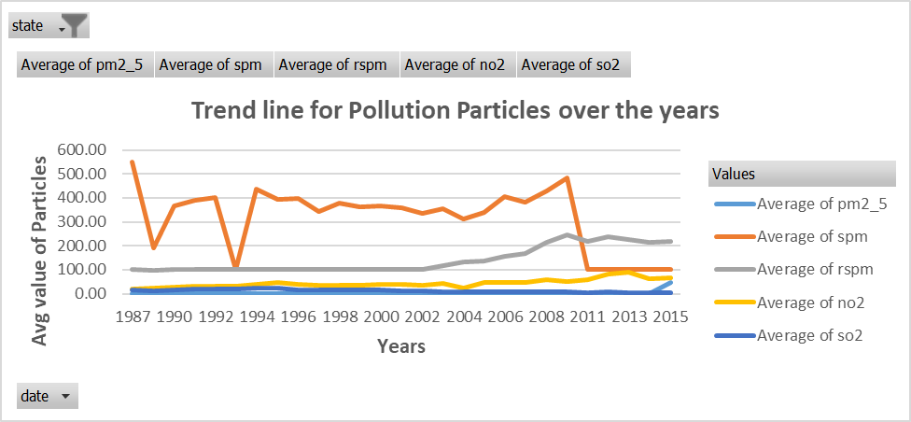
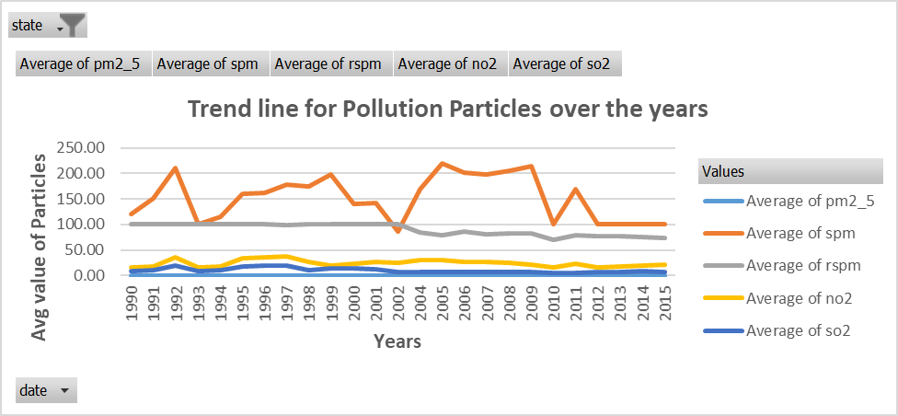
Delhi
Andra Pradesh

Slide 14
Average Pollution caused by So2 per Sector
OBJECTIVE 9
RESULT AND ANALYSIS :
So2 Emission is mostly high in Industrial Areas

Slide 15
Average Pollution caused by No2 per Sector
OBJECTIVE 10
RESULT AND ANALYSIS :
No2 Emission is high in all sectors be it industrial, residential, rural etc.

Slide 16
Average Pollution caused by RSPM per Sector
OBJECTIVE 11
RESULT AND ANALYSIS :
We see that emission of RSPM is slightly high in sensitive areas and is also a cause of concern.

Slide 17
Average Pollution caused by SPM per Sector
OBJECTIVE 12
RESULT AND ANALYSIS :
We see that emission of SPM is also slightly high in sensitive areas and is also a cause of concern.

Slide 18
Average Pollution caused by PM2_5 per Sector
OBJECTIVE 13
RESULT AND ANALYSIS :
We see that emission of PM2_5 is not significant enough and is quite even in most sector.

Slide 19
THANK YOU

